Slide 1


Pay How you Drive
Autosmart

Slide 2
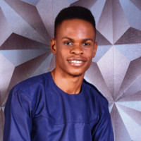
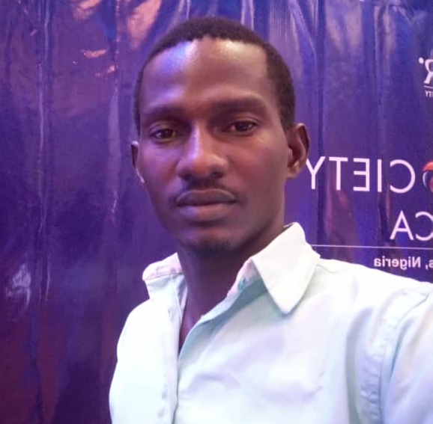
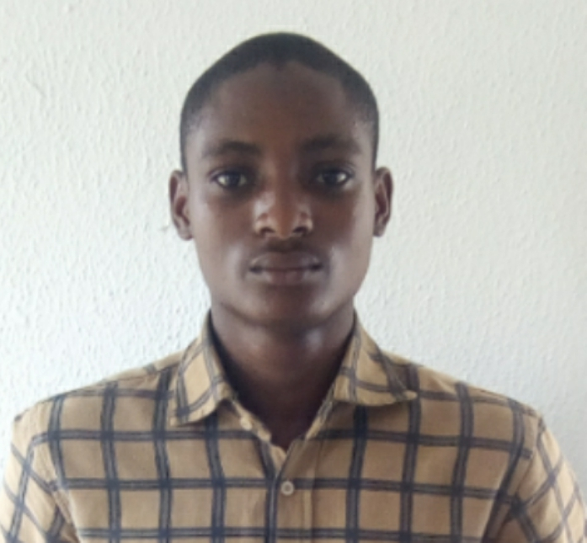
Team
We have a proven track record and vision to succeed
Okon Emmanuel - CEO
First Class Graduate of Statistics
Recognized and awarded by FirstBank
Yunus and Youth Global Fellow
Salami Tosin- COO
Insurance Industry Expert
Publisher at Interview Stories
Alaba Ridwan- CTO
Embedded Systems Engineer
Intel Ambasador
http://autosmart.com.ng
Pitch Deck | Vmedkit

Slide 3
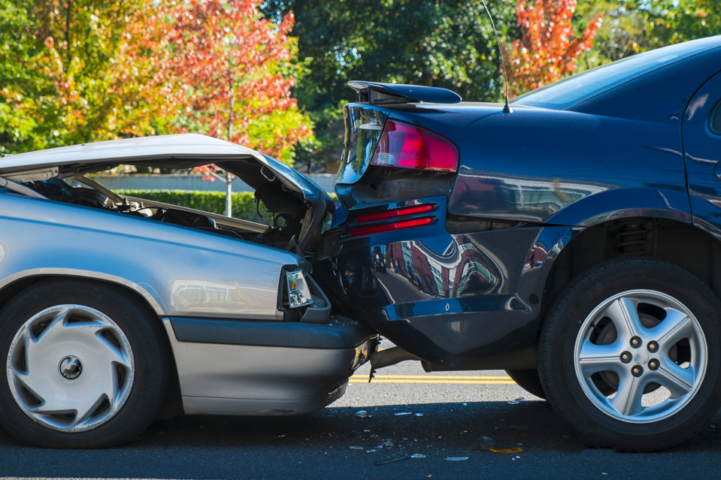
Problem
90%
of third party insurance certificates issued are fake
$250 Million
has been lost to fraudulent insurance claims in Nigeria
http://autosmart.com.ng

Slide 4
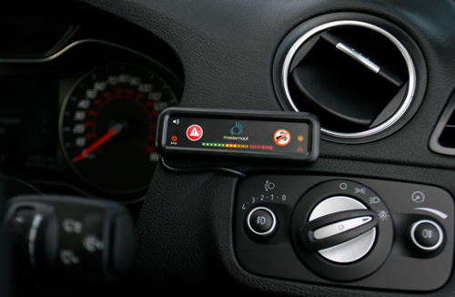
Solution
How we’re solving this problem
Autosmart is leveraging Artificial Intelligence (AI) and Internet of Things (IoT) technology to combat fraudulent automobile insurance claims.
We have built a device that uses telematic and GPS sensors to analyze and report on the compliance of an individual.

Slide 5

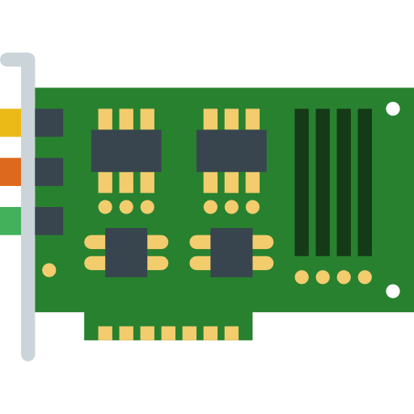

Uniqueness
Our unique value proposition
First to Market
Device Driven
Personalized
http://autosmart.com.ng
Pitch Deck | Vmedkit

Slide 6






How It Works
Demo Walkthrough
Data Transmission to our gateway
Data encrypted and secured
Easily verify claims and issue cheaper premiums
1
2
3
4
5
6
Telematics Device Installed
Progressive server collects data
Insurance companies access this data
http://autosmart.com.ng
Pitch Deck | Vmedkit

Slide 7

http://autosmart.com.ng
Pitch Deck | Vmedkit

